Slide 1
Swelling of Stainless Steel under Fast fluence
NE795
Fall 2021

Slide 2
Swelling of Stainless Steel under Fast Fluence
Outline
What is swelling?
Why do we need to study it?
What is SS ?
Why SS specifically ?
Swelling behavior.
Parameters affecting swelling.
How to improve swelling resistance.
Importance of study

Slide 3
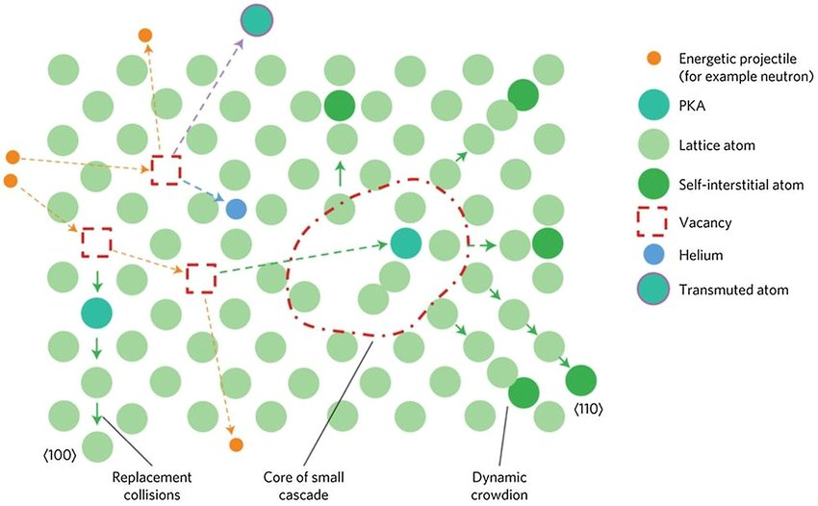
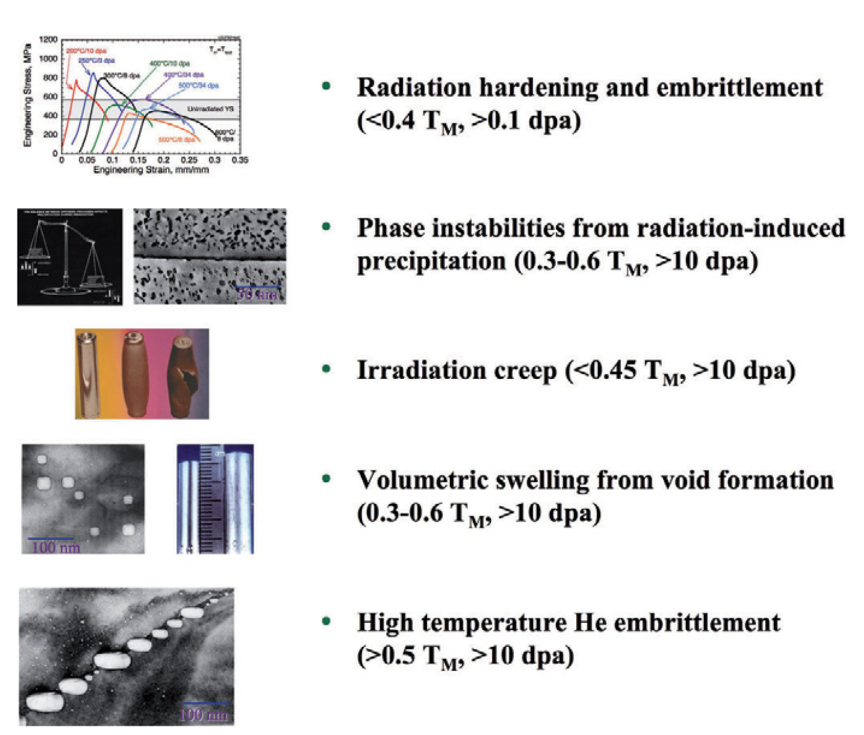
Radiation Damage Threats
Under irradiation, material atoms are displaced at very high rate (dpa).
Defect super-saturations created and reach steady state when their rate of annihilation at sinks equals the production rate.
A net flow into the sinks will lead to enhanced deformation, dimensional instability.
Swelling is one of the dimensional instability consequences of radiation damage.
Swelling lead to increase in volume and decrease in density.
Swelling depend on;
Material.
Crystal structure.
Composition.
Precipitates.
Temperature.
Helium content.

Slide 4
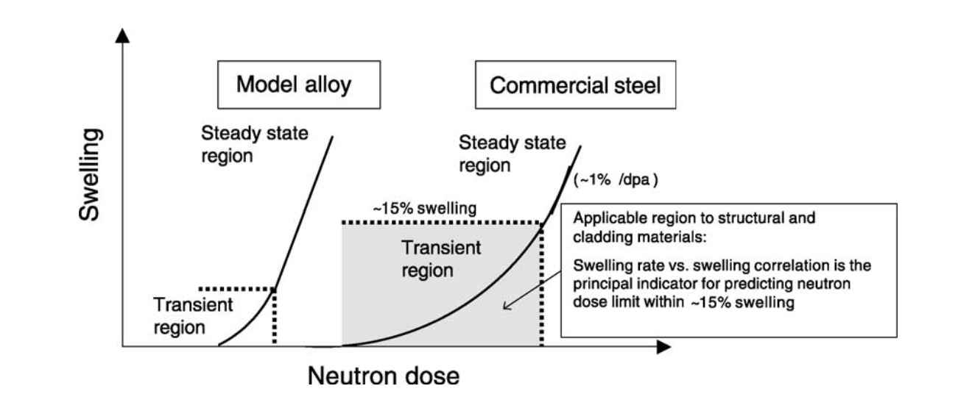
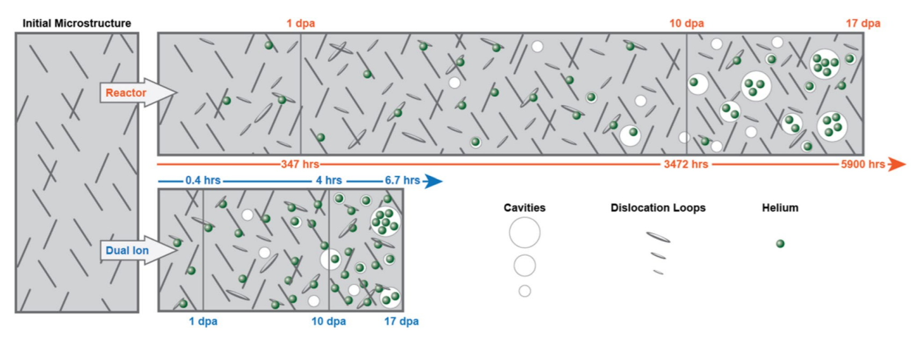
Swelling
For most metals, void swelling occurs in a temperature range 0.3 to 0.55 of the absolute melting temperature.
The microscopic mechanism is the formation of small cavities in the solid, perhaps with a little gas in them which help stabilize the void embryos.
Void swelling has an incubation period, transient period followed by a steady state regime.
During incubation and transients periods void nucleation occur.
During steady state regime, there is a net bias allowing voids to grow in size.
The net bias determines the max swelling rate.
FCC metals (1%/dpa).
BCC metals (0.2%/dpa).
Schematic view of neutron dose dependence of swelling for commercial austenitic stainless steels (AISI 316) and related ternary model alloys (Fe–Cr–Ni)
Notes:
For materials like stainless steel there is a threshold fast neutron fluence below which voids are not observed (10^22 n/cm2).
Incubation time= time it takes before we start to see voids
Emitted vacancies from voids
With helium its called inclusion
Interstitials are attracted to dislocations more than to vacancies because dislocation cause more distortion in the crystal than vacancies.

Slide 5
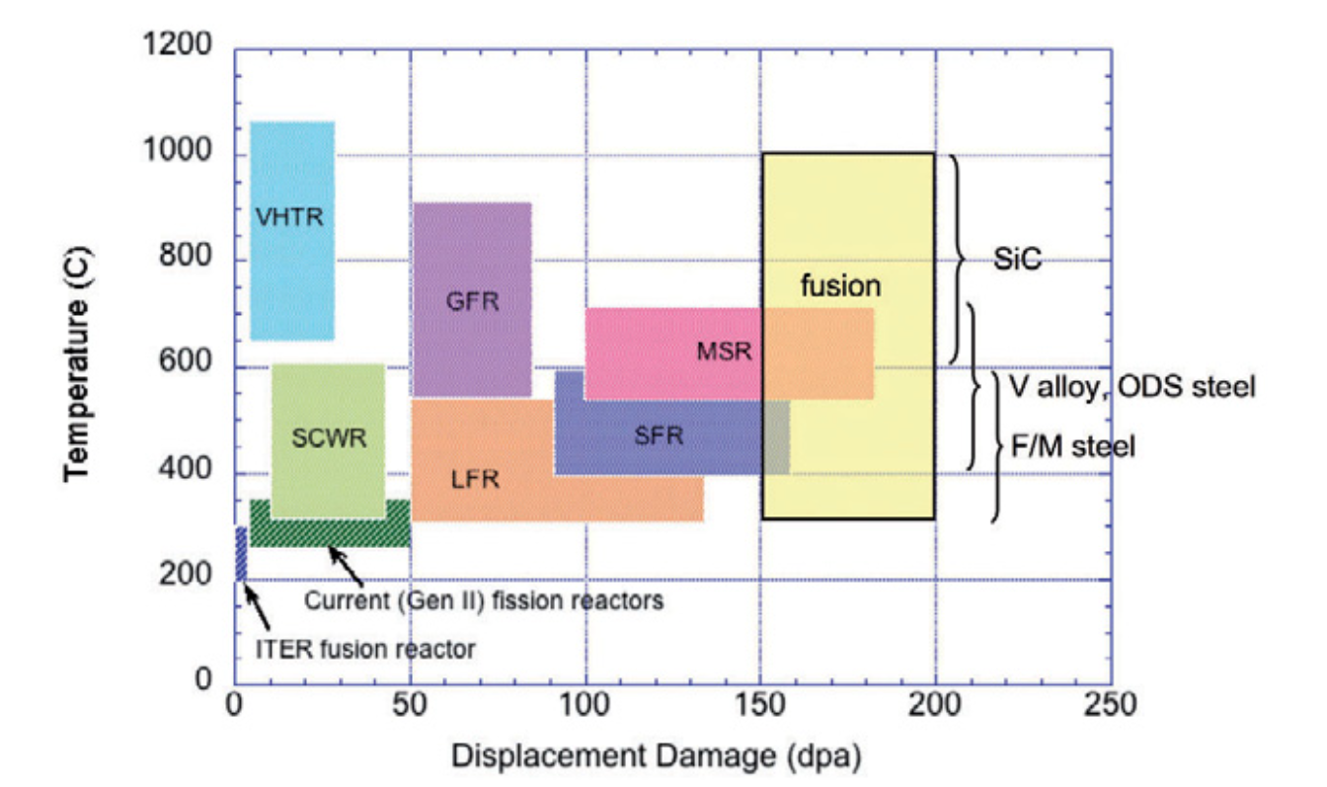
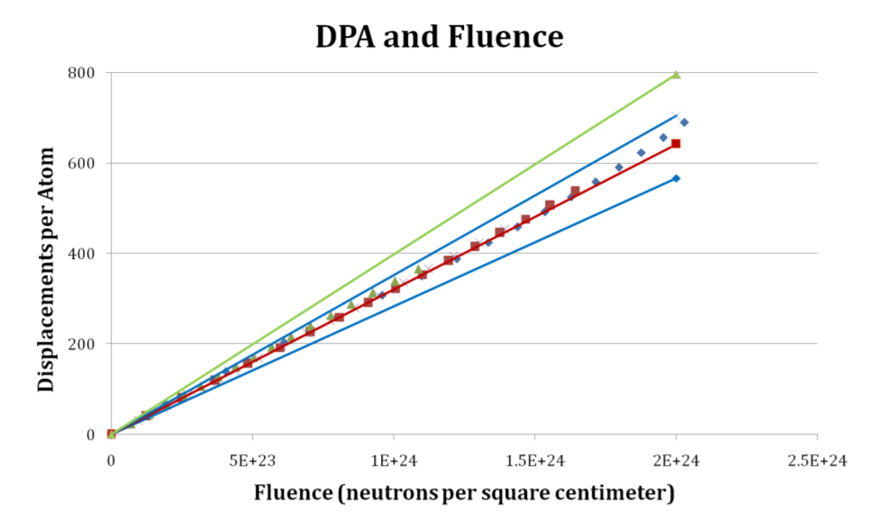
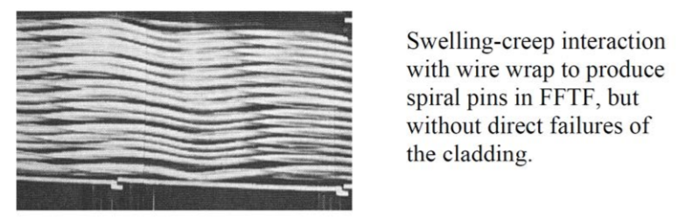
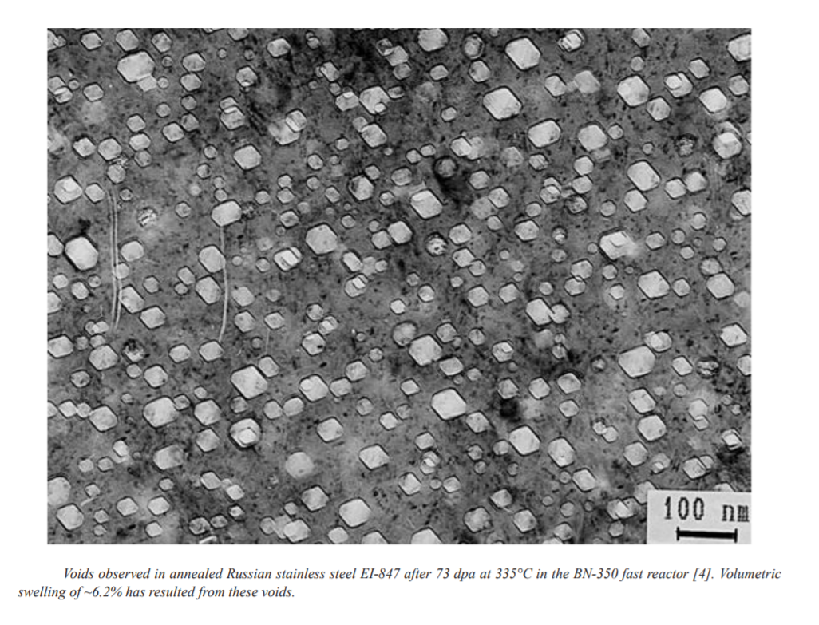
Fast Fluence
Swelling is mainly due to radiation induced defects.
Gen IV reactors environments have higher fast fluence and higher dpa more than LWRs.
Such harsher environment will increase the probability of swelling and materials failure.

Slide 6
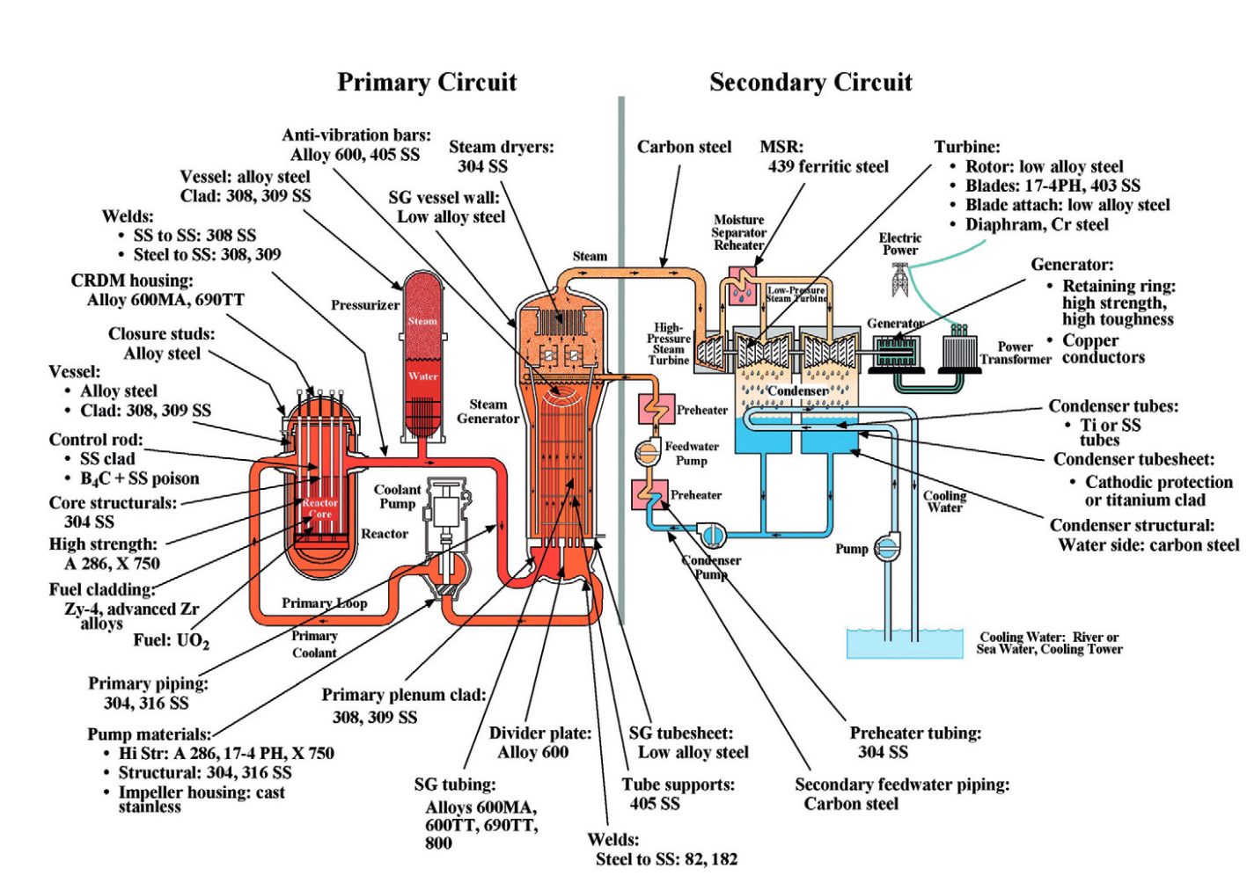
Stainless Steel
Austenitic stainless steels are widely used in nuclear reactors. For instance, in pressurized water reactors (PWRs), austenitic stainless steel 304 is used for core structurals and piping.
Austenitic stainless steels 308 and 309 are used for vessel cladding.
In fact, most of the core structural materials are austenitic stainless steels, due to their excellent aqueous corrosion resistance at high temperatures.
The most representative clustered defects in austenitic stainless steels are Frank faulted loops.
Austenitic stainless steels are used for core internal structures in sodium-cooled fast reactors (SFRs).

Slide 7
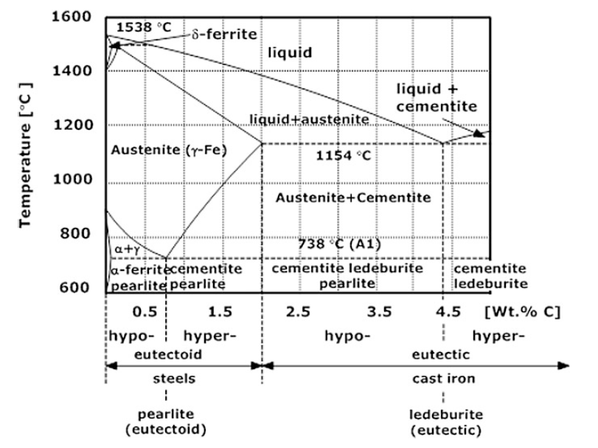
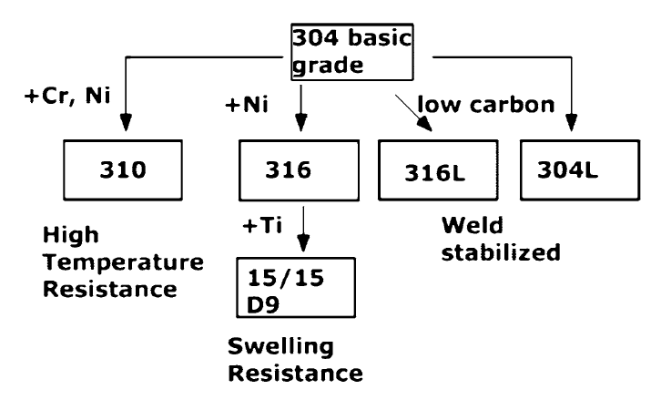
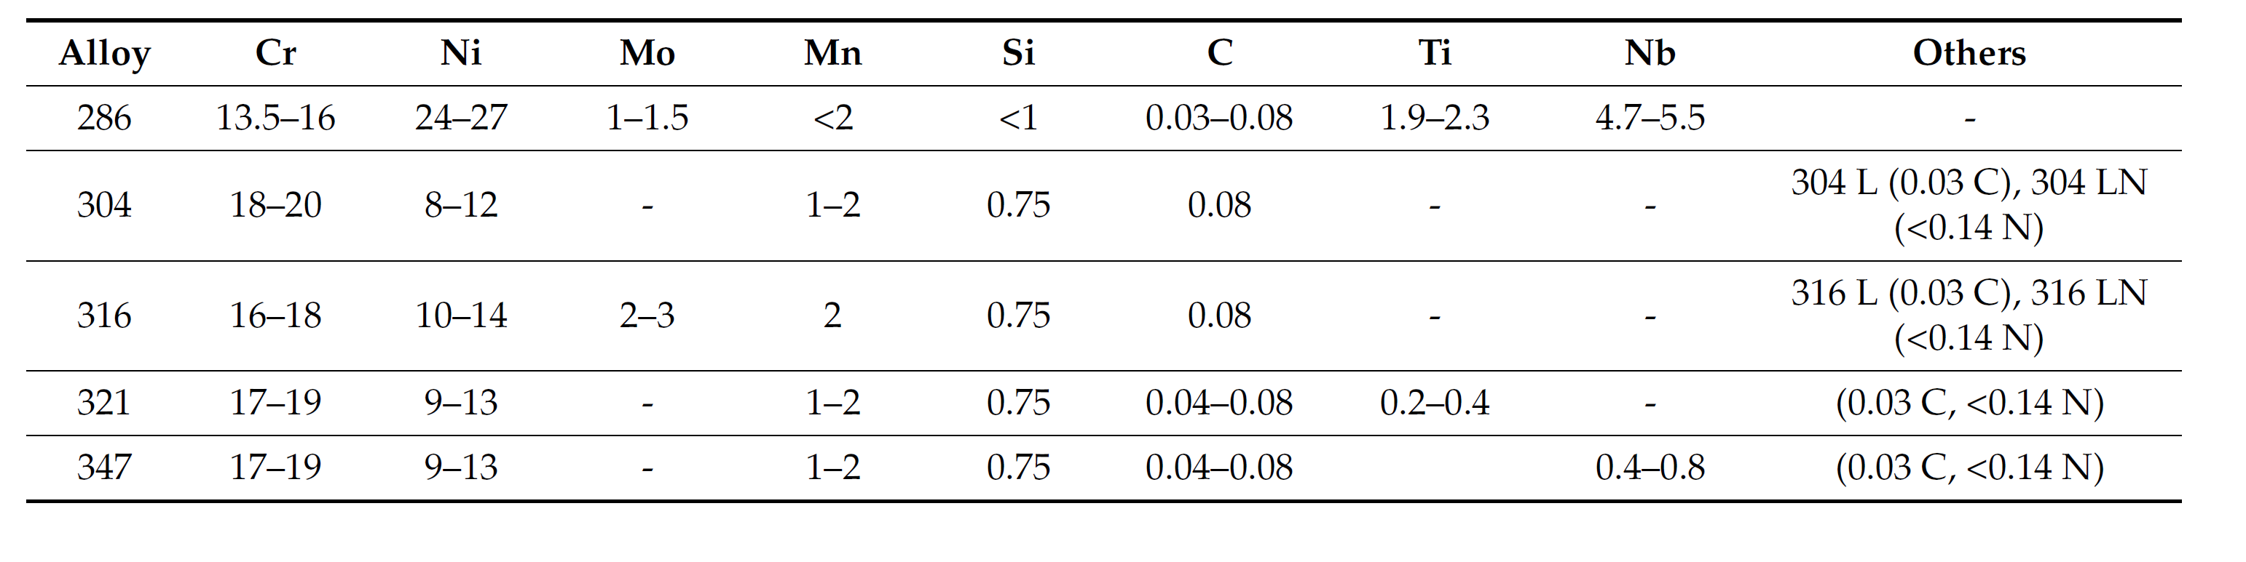
Stainless Steel

Slide 8
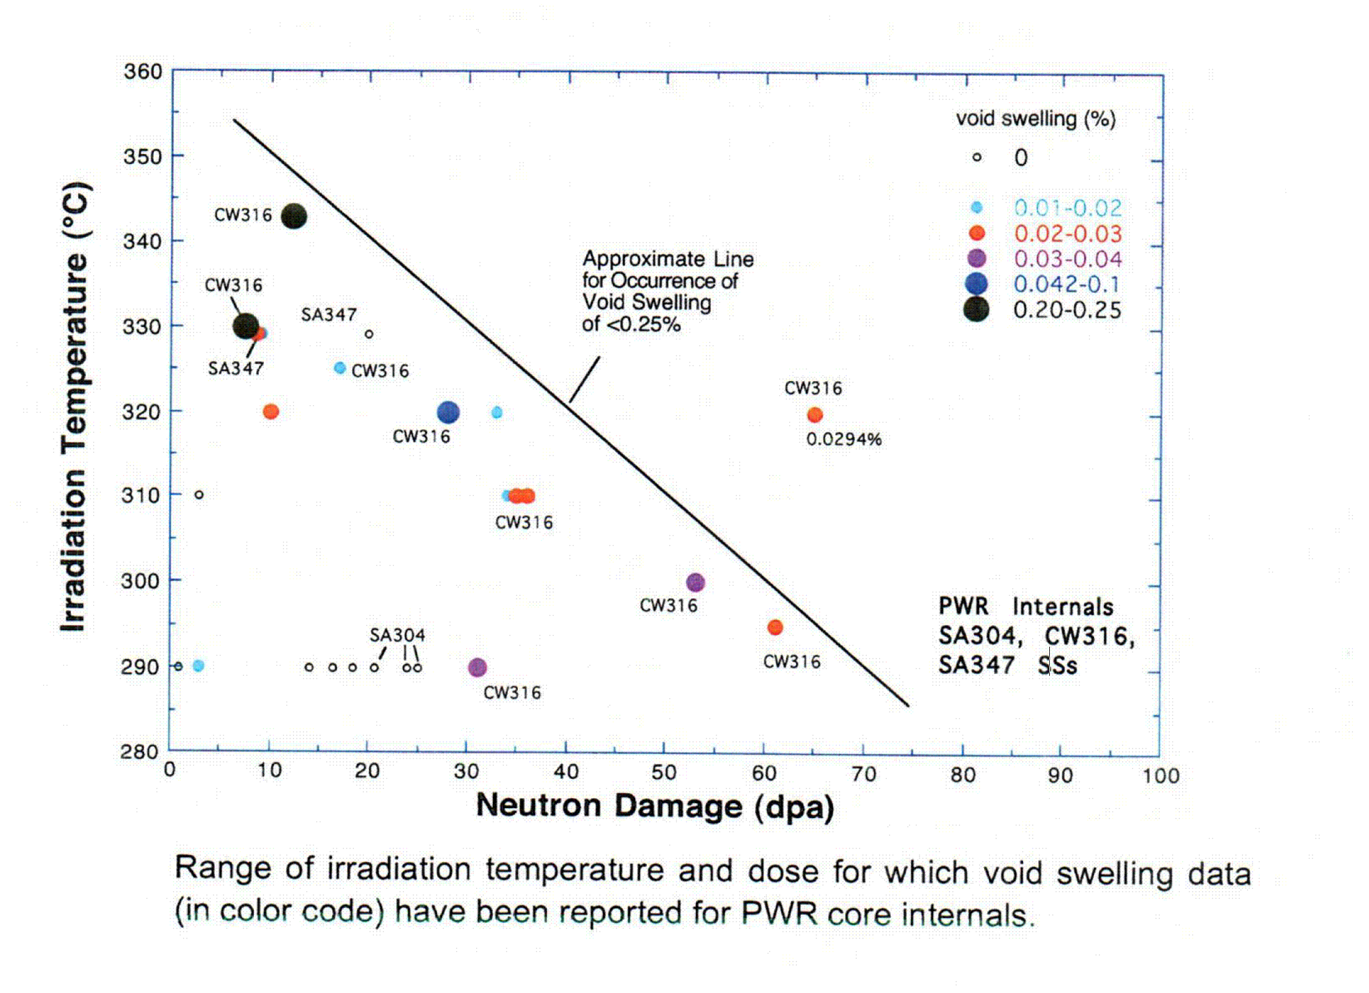
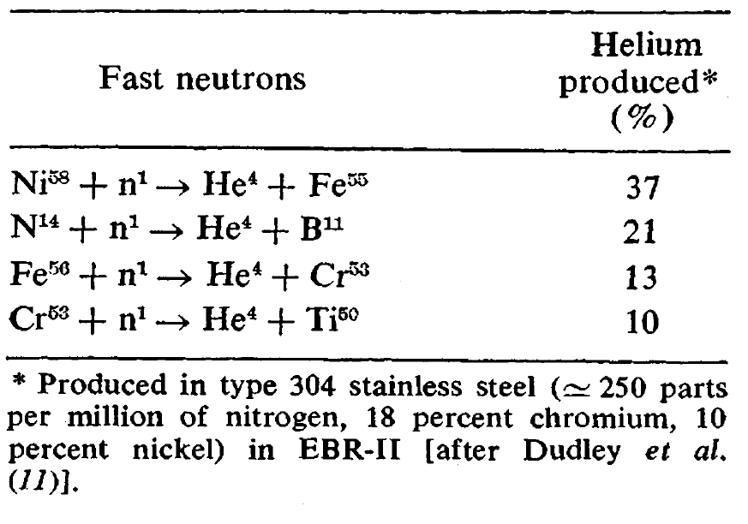
Stainless Steel Swelling Behavior
At intermediate temperatures, void swelling becomes one of the most concerning radiation effects for austenitic stainless steels, especially at high doses.
Transmutation of stainless steel elements into Helium will increase the probability of voids stability and will add to the increased swelling rate.
Notes:
Vacancy diffusion mechanism

Slide 9
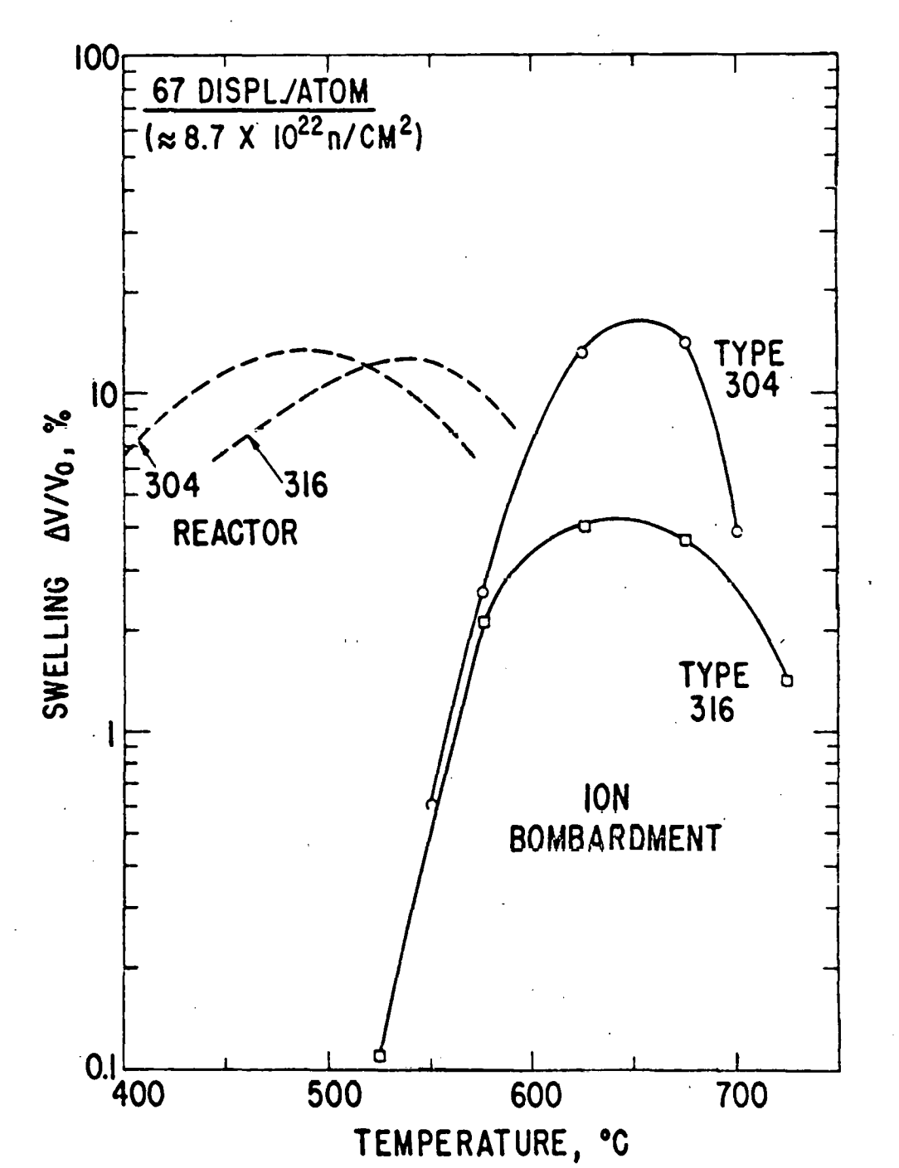
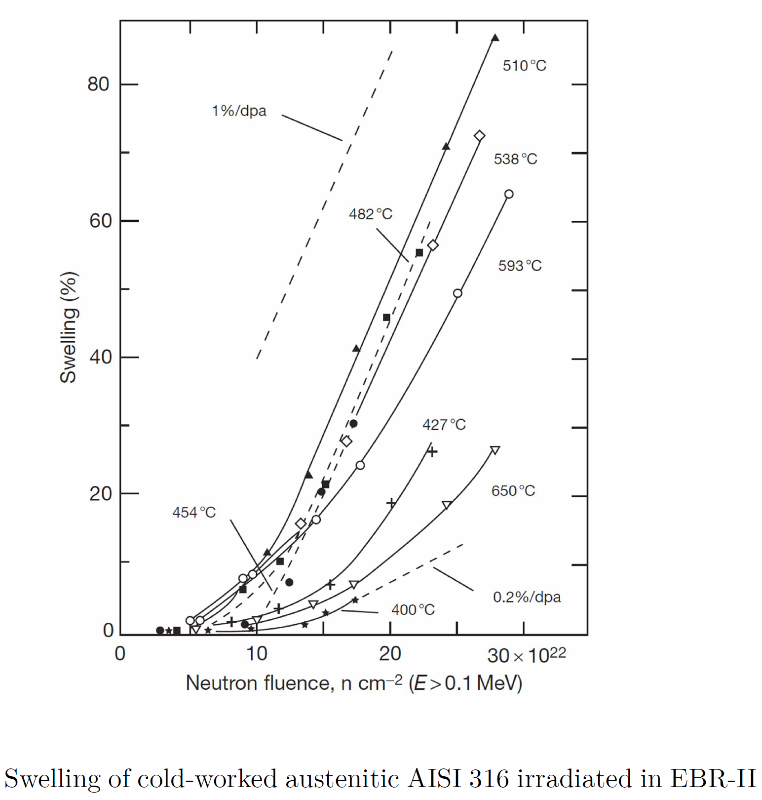
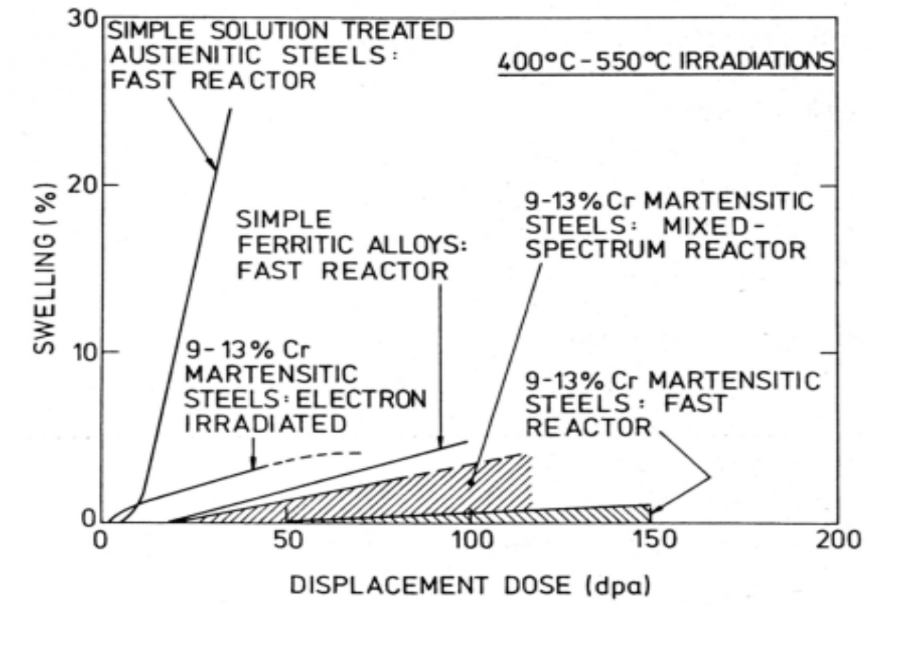
Stainless Steel Swelling Behavior

Slide 10
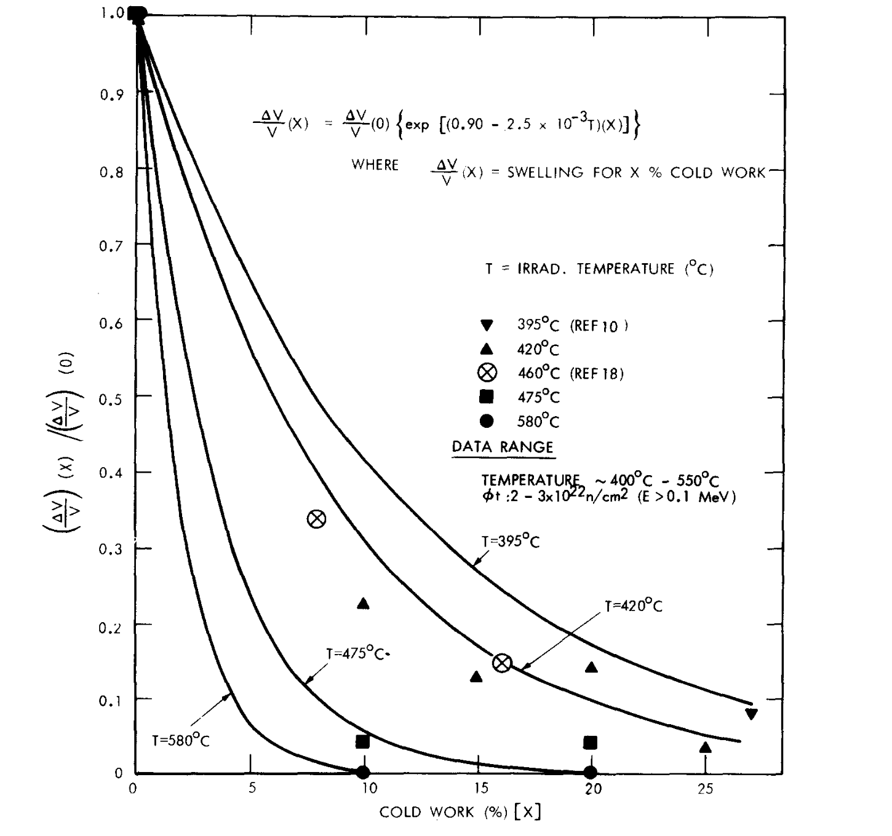
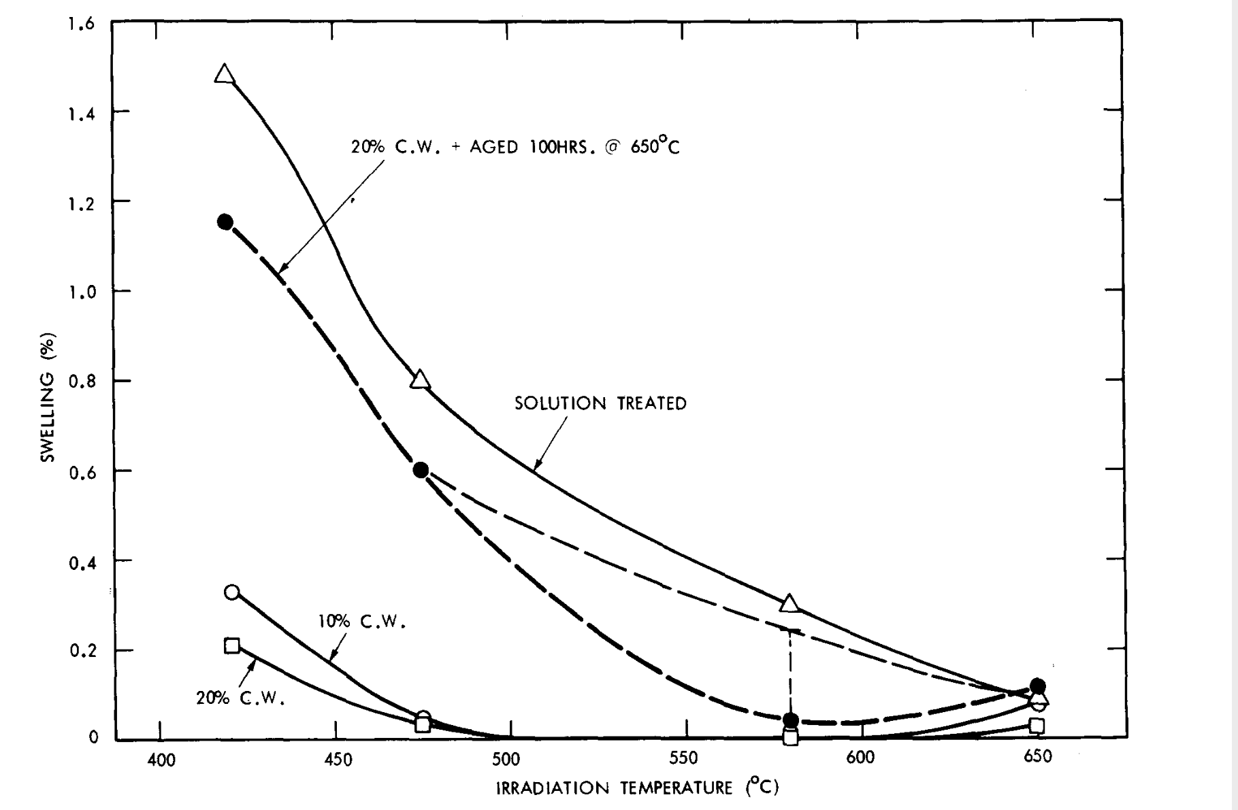
Effect of cold working
Cold work changes dislocation network density and has been found to have a significant effect on the swelling characteristics of metallic materials.
The higher dislocation density restricts the nucleation and growth of voids.
The effects of cold work and fluence reveal that the same amount of cold work provides less effect at higher fluences since cold work enhances the incubation dose for swelling but does not diminish the swelling rate in the linear swelling region at higher doses.
Increasing the cold work level decreased the swelling in type 316 stainless steel.
The reduction in swelling is due to a decrease in both void number density and void size.

Slide 11
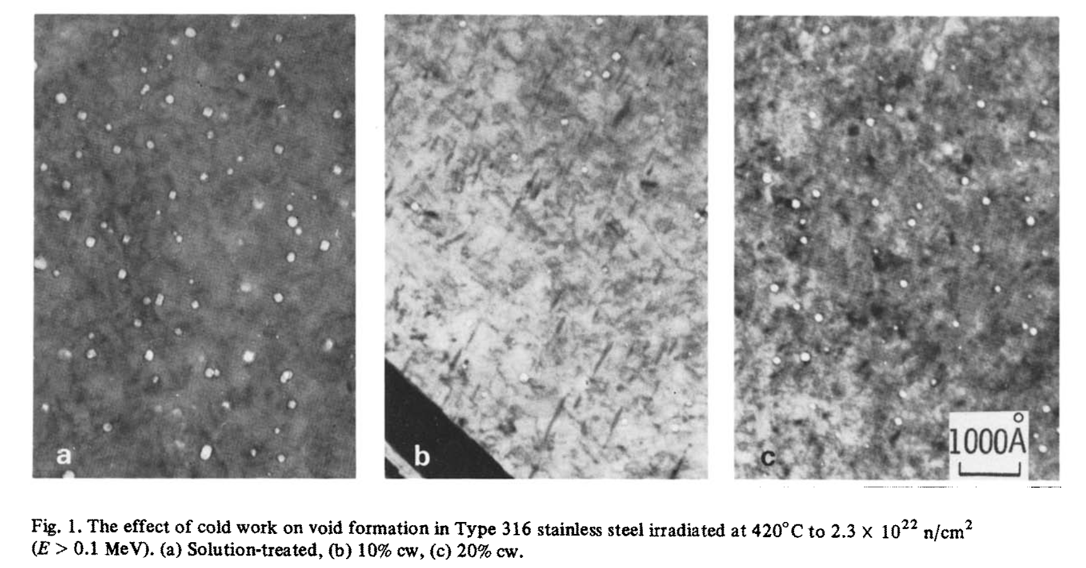
Effect of cold working
Cold working from 0 to 10% more effectively suppresses void-number density and swelling than by increasing the CW level from 10 to 20%.

Slide 12
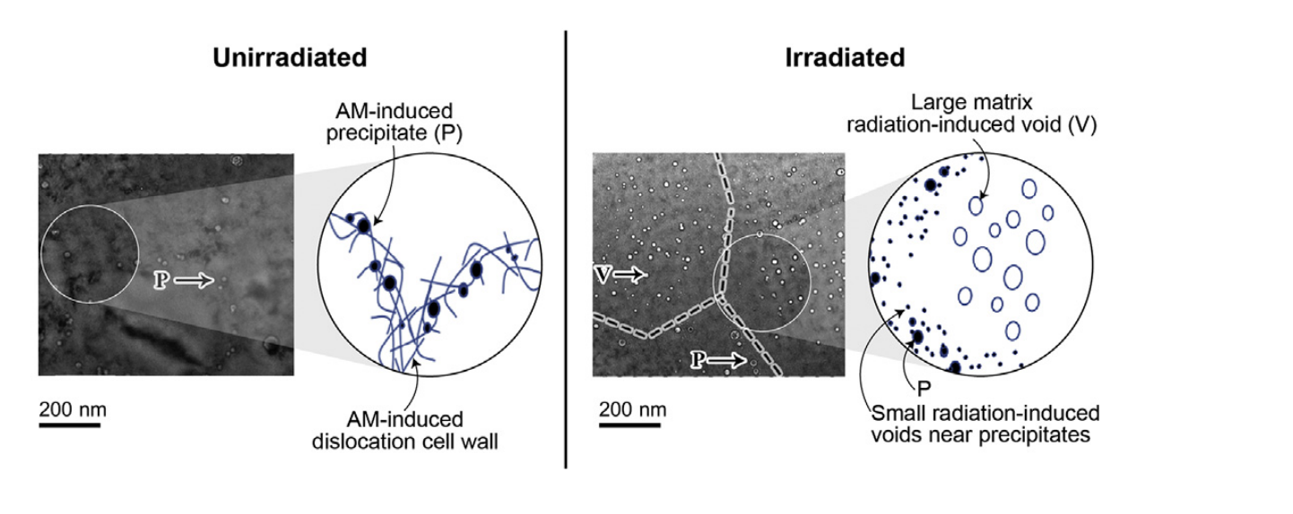
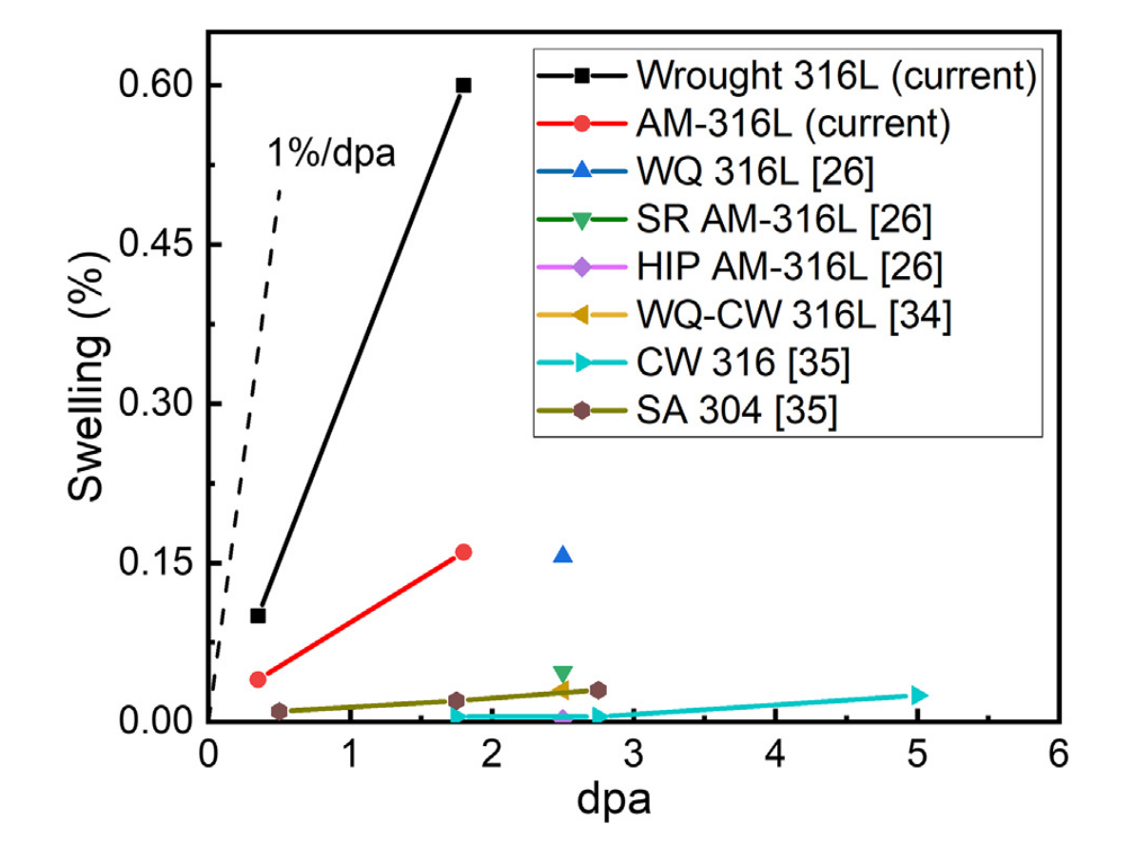
Effect of Fabrication process
The microstructure developed during metal additive processing is notably different from the one developed in conventional processing.
Solidification-induced dislocation and precipitate structures affect swelling behavior.
The strong sink bias for interstitial point defects exerted by density of pre-existing dislocations will affect swelling behavior.
Void swelling was inhibited in the vicinity of pre-existing precipitates.
Notes:
The radiation-induced swelling response of a laser powder-bed fusion-manufactured austenitic stainless steel was investigated at high doses.

Slide 13
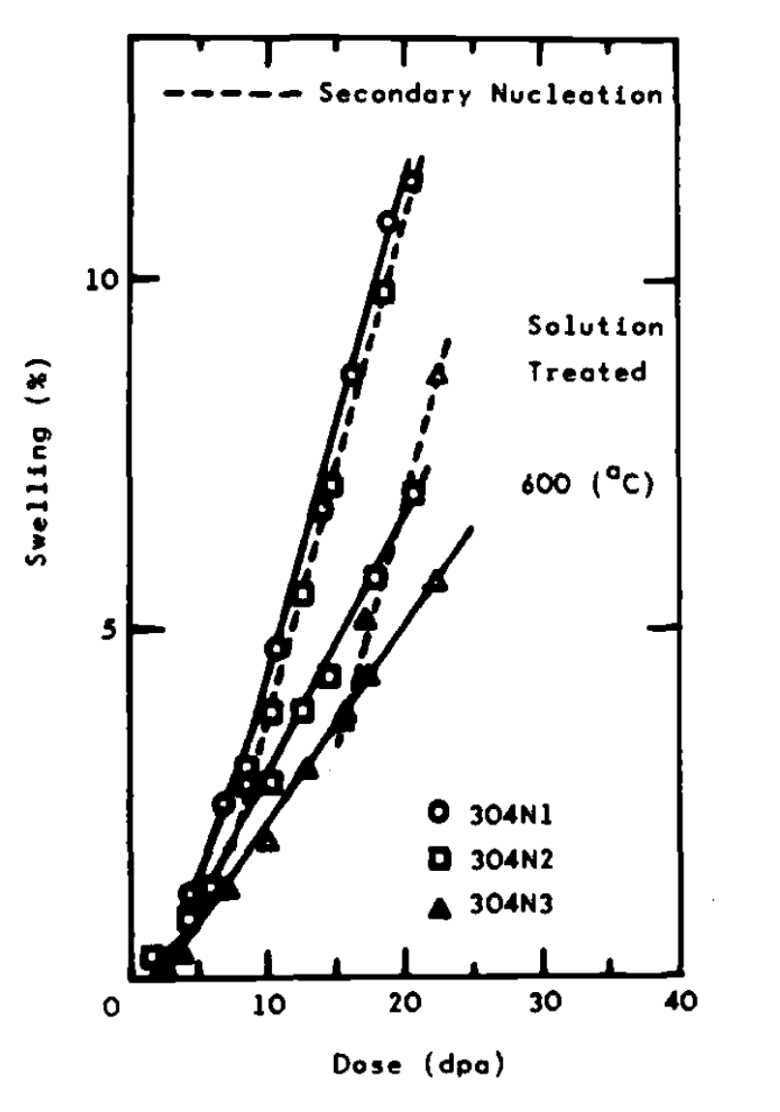
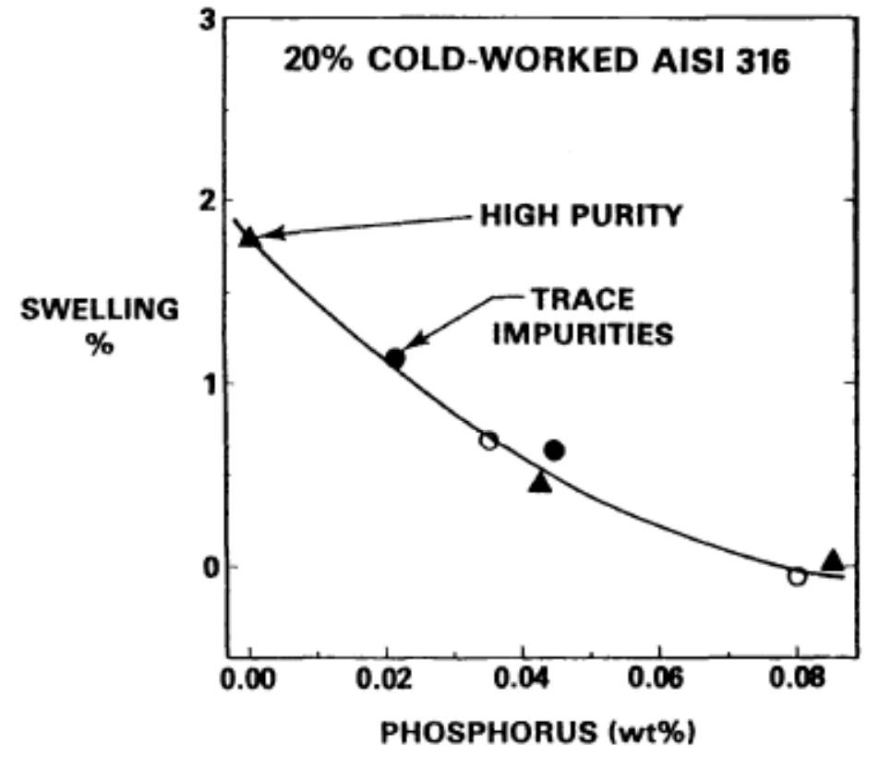
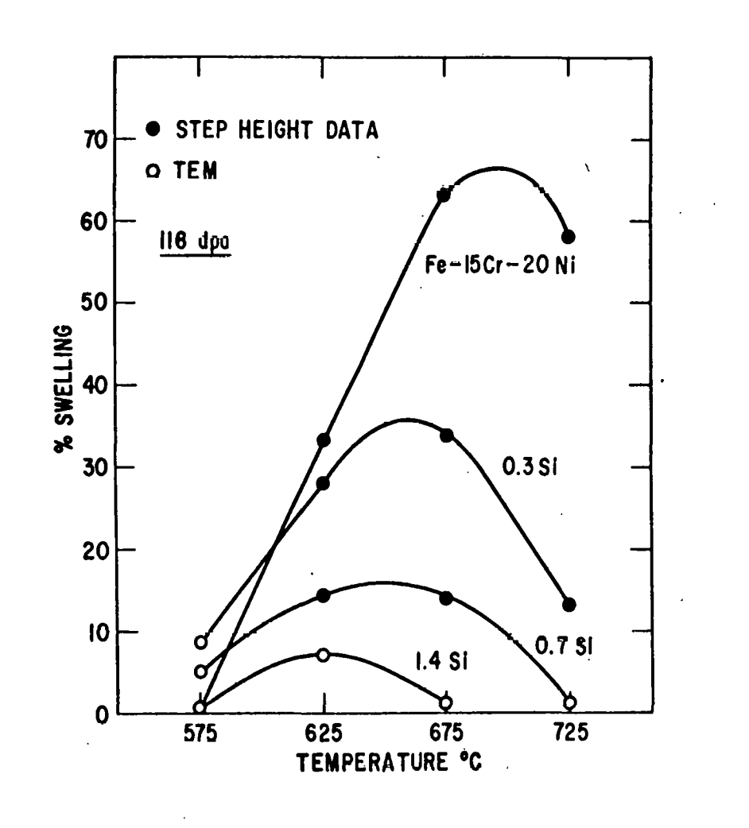
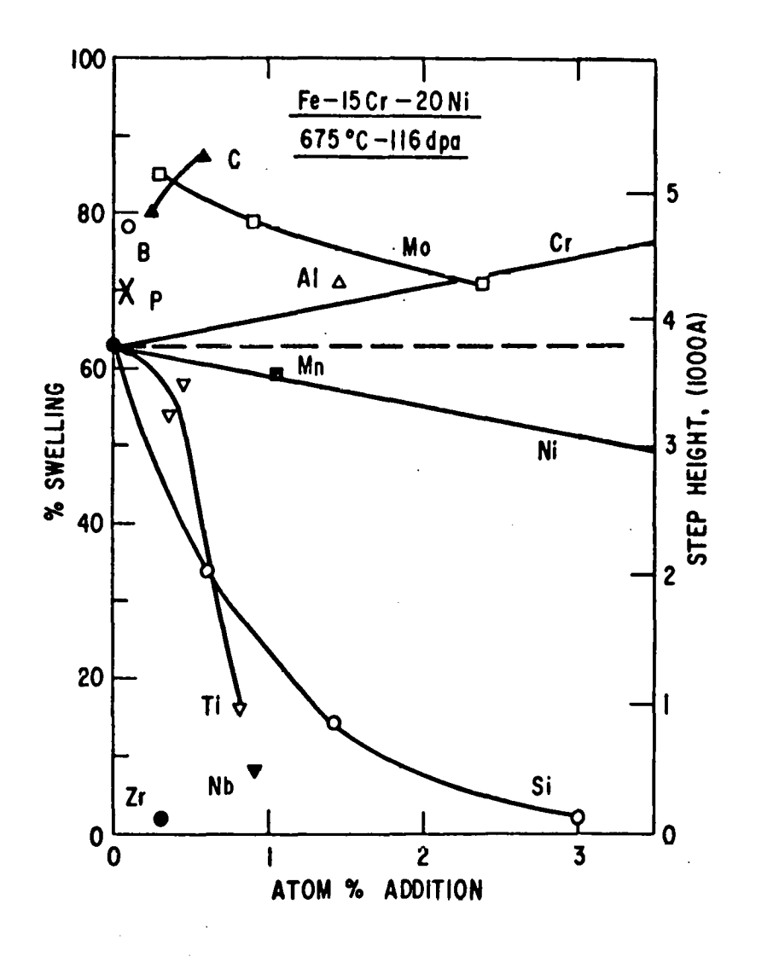
Effect of impurities
Introduction of impurity atoms (titanium & niobium) decrease swelling.
Soluble atoms bind with point defects, reducing mobility and encouraging recombination.
Ni content increase incubation periods and prolongs transient region.
Notes:
Trend shows
Increasing binding energy.
Increased activation energy of voids.
Void growth suppressed.

Slide 14
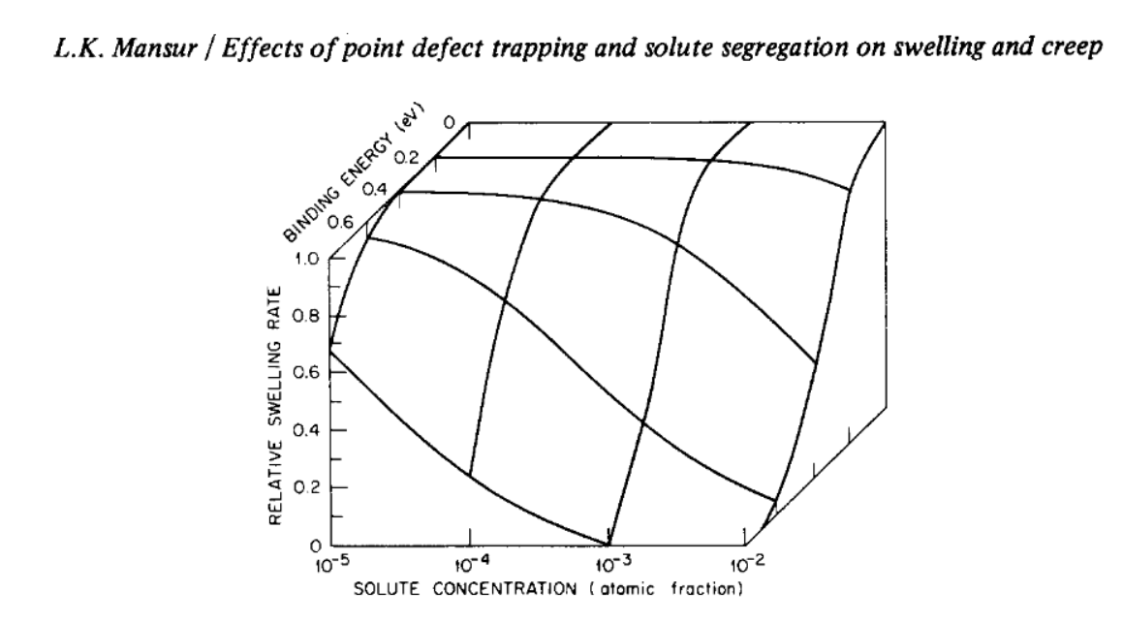
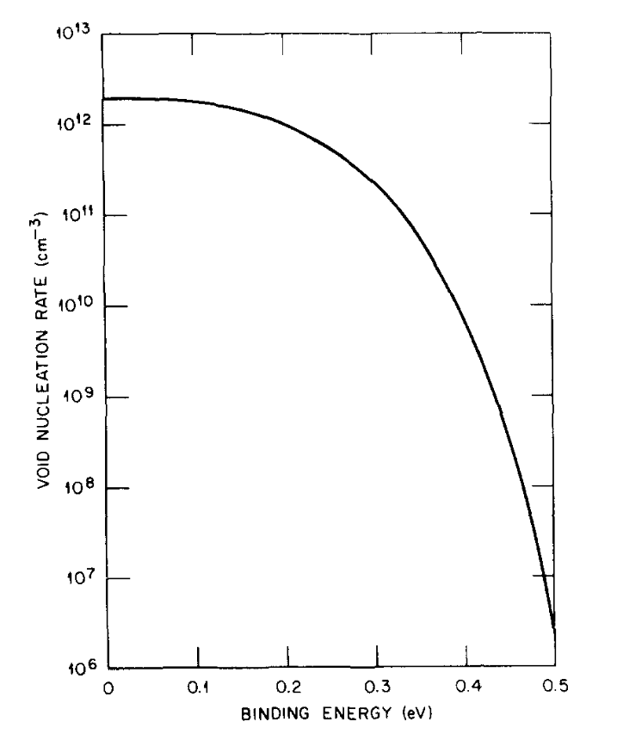
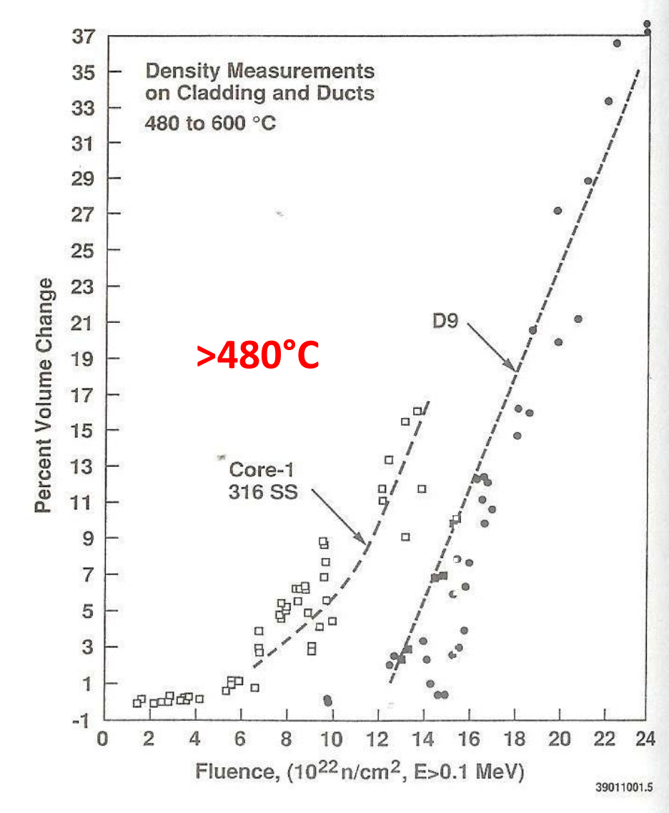
Effect of titanium in solid solution
The major role played by titanium in solid solution is to limit the swelling.
The creation of solute-vacancy complexes (s-v) can act as recombination sites for vacancies and interstitials.
When the recombination processes are enhanced, the vacancy Super-saturation decreases. Hence the swelling is reduced.
these complexes are formed more easily with solutes having a bonding energy with vacancies greater than 0.2–0.3 eV. For titanium, Ev–Ti = 0.3 eV.
The behavior is called impurity trapping
Notes:
Ti-modified stainless steel designated D9

Slide 15
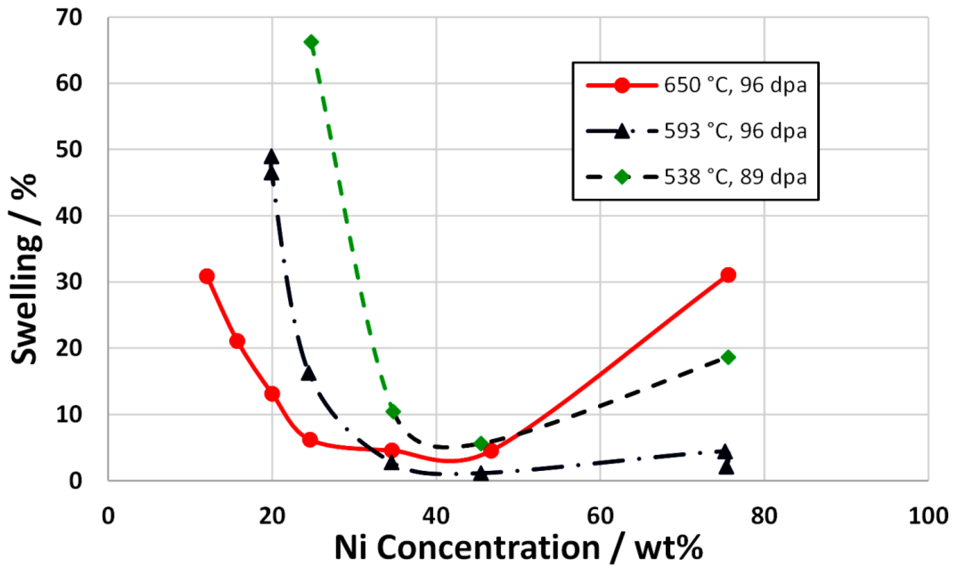
Effect of sinks density
the presence of a fine precipitation combined with a dense dislocations stabilize the dislocations which are sinks for vacancies and interstitials.
The super-saturation of vacancies is decreased and consequently the void nucleation is decreased as well.
Effect of nickel in solid solution
Ni is known to increase the incubation dose for swelling.
The high Ni–v binding energy (Ev–Ni = 0.26 eV) could contribute to the formation of Ni–v clusters. Hence, these complexes would decrease vacancies mobility, act as recombination sites for punctual defects or as nucleation sites for cavities.
This leads to higher cavities density but a decrease of the swelling.
This behavior is very sensitive to Ni percent.
Notes:
Transmutation reactions

Slide 16
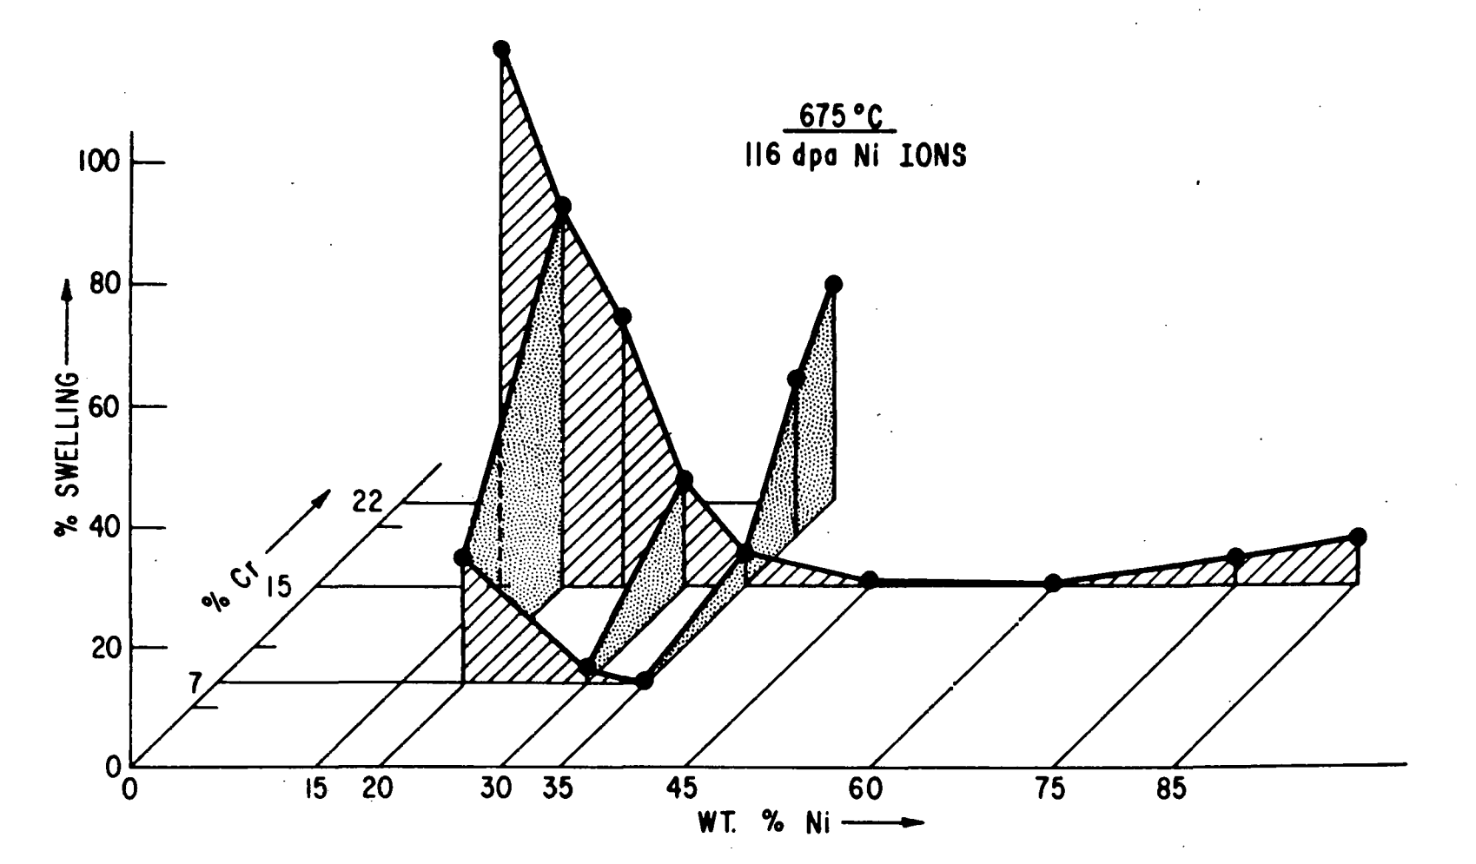
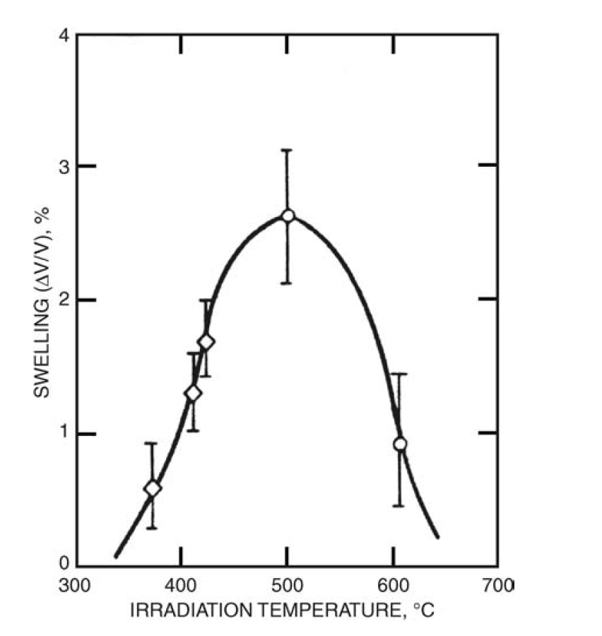
Effect of Cr in solid solution
The graph shows the change of the iron-chromium-nickel stainless steel swelling behavior with changing the Ni and Cr w%.
Effect of Temperature
the peak in swelling happens at the intermediate temperature. Lower defect mobility limits void growth at lower temperatures, whereas at higher temperatures the irradiation-produced defect concentration reaches the value close to thermal equilibrium value and loses the level of vacancy super-saturation

Slide 17
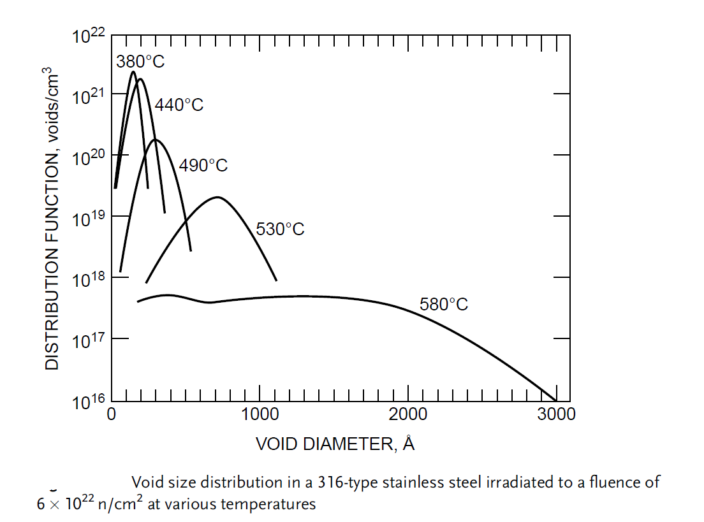
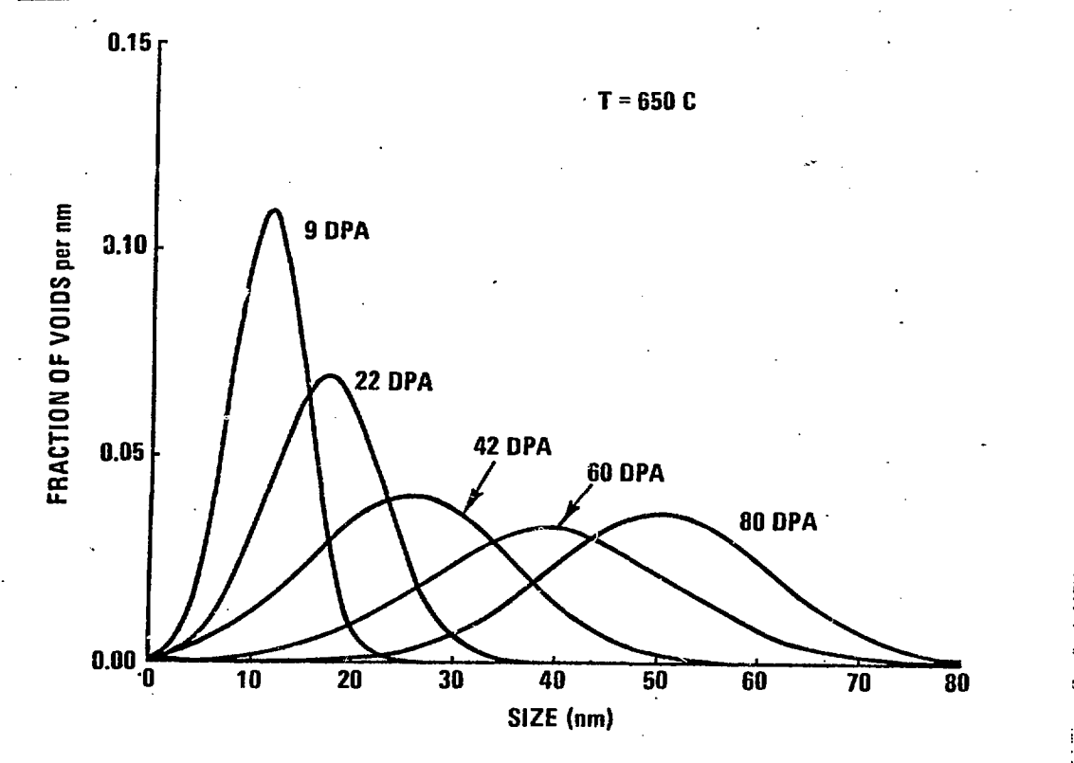
Effect of dose and temperature on the size of voids
Experimentally measured size distributions in an ion-bombardment iron-nickel-chromium alloy.

Slide 18
Conclusion
Swelling is one of the dimensional instabilities occurring as a consequence to radiation induced defects.
Fast fluence reactors have high dpa value, which in turn means higher probability of swelling.
Austenitic stainless steels show lower swelling resistance in comparison with other steels.
Swelling of austenitic stainless steels is affected by a number of parameters.
Impurities.
Ni and Cr content.
Ti content.
Dislocations loops density.
Temperature.
Displacement per atom.
Cold-Work and fabrication process.

Slide 19
Questions

